Slide 1
Analysis Presentation

Slide 2
Background
Datasets were collected from BTS statistics and the US Census Bureau for the aviation and population-related data respectively
Census data spans from 2010-2020
Aviation data spans from 2010-2021
Tools Used:
Tableau Desktop
Tableau Prep Builder
Google BigQuery
Excel

Slide 3
Primary: To explore the growth in population of the Austin and Nashville Metropolitan Areas and its relation to aviation performance metrics.
Secondary: To explore how the COVID-19 pandemic impacted the aviation KPI’s for Austin and Nashville - and their rebound in 2021
Objectives

Slide 4
Metric (and other) Definitions
AUS = Austin, Texas / Austin-Bergstrom International Airport
BNA = Nashville, Tennessee / Nashville International Airport
Nat/National = United States
Flights = Individual Flights - one-way segments - Flown.
Ex. JFK - LAX (one-way) is one flight
PAX = Number of passengers enplaned/flown
ASM = Available Seat Miles
# of seats available * # of miles flown
RPM = Revenue Passenger Miles
# of passengers * # of miles flown
LF = Load Factor
RPM/ASM
Covid-Bounceback Rate
2021 statistic / 2019 statistic
Aviation-related metrics to illustrate the “bounceback” ability of the industry from 2019 to 2021.

Slide 5
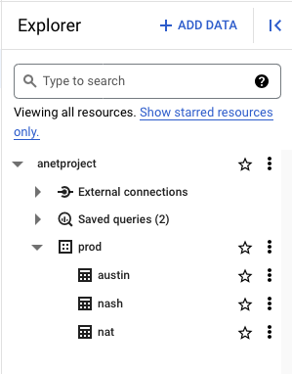
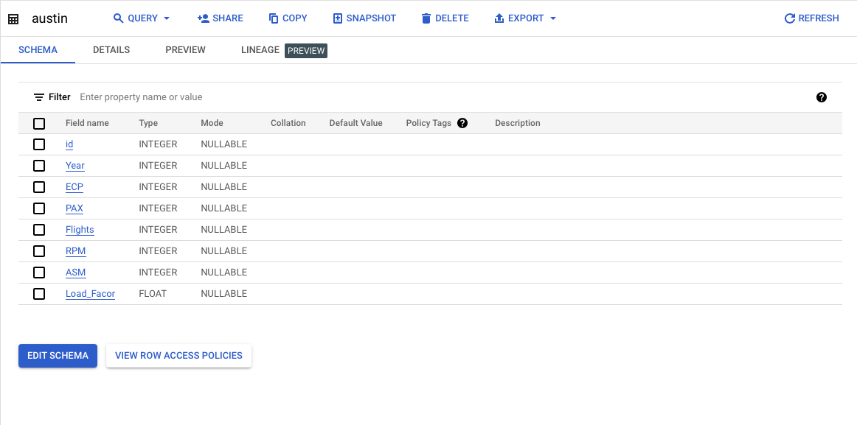
Data Storage
For data storage and querying, I used Google BigQuery.
I have familiarity with the platform, and I usually connect Tableau Desktop directly to the active project I am working with.
Cleaning was done via Excel and Tableau Prep Builder before loading into BigQuery.

Slide 6
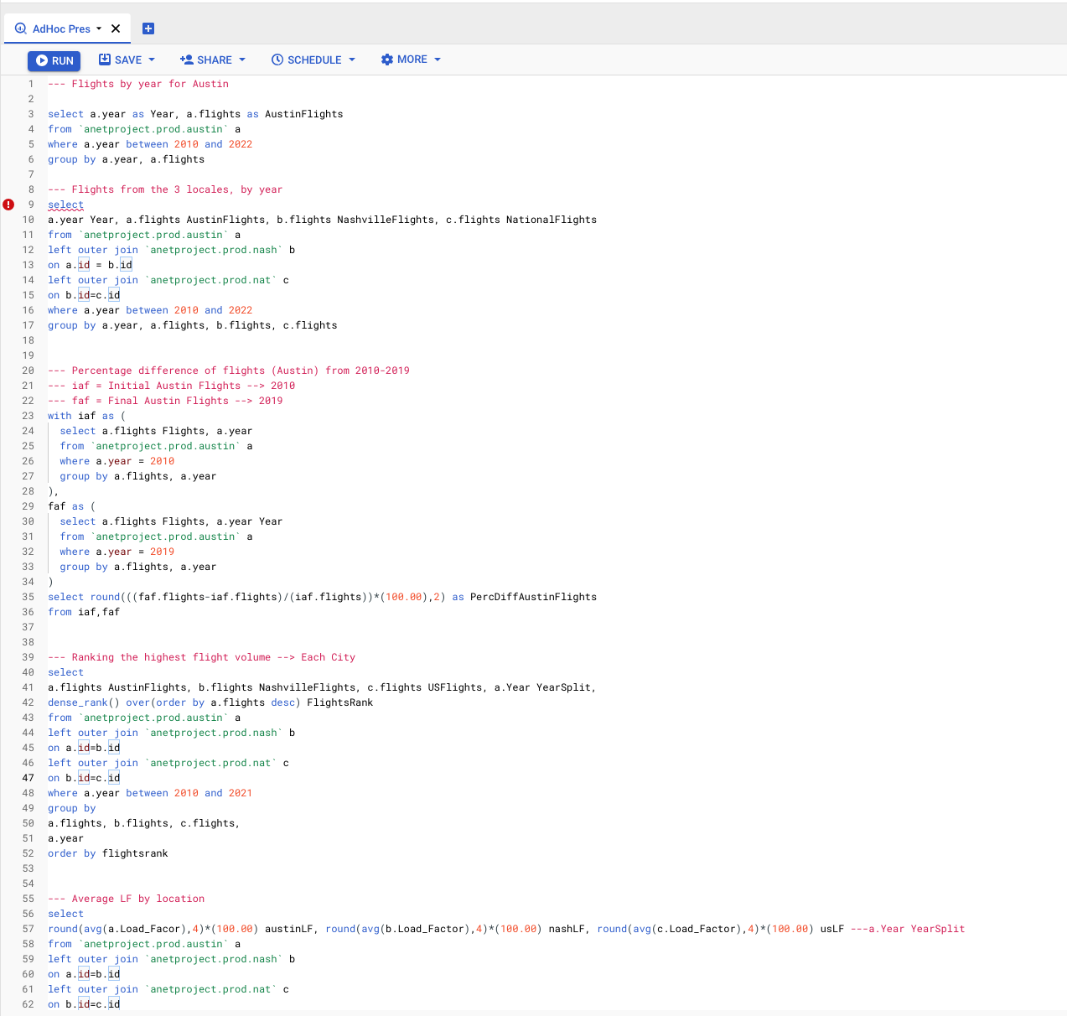
SQL Querying

Slide 7
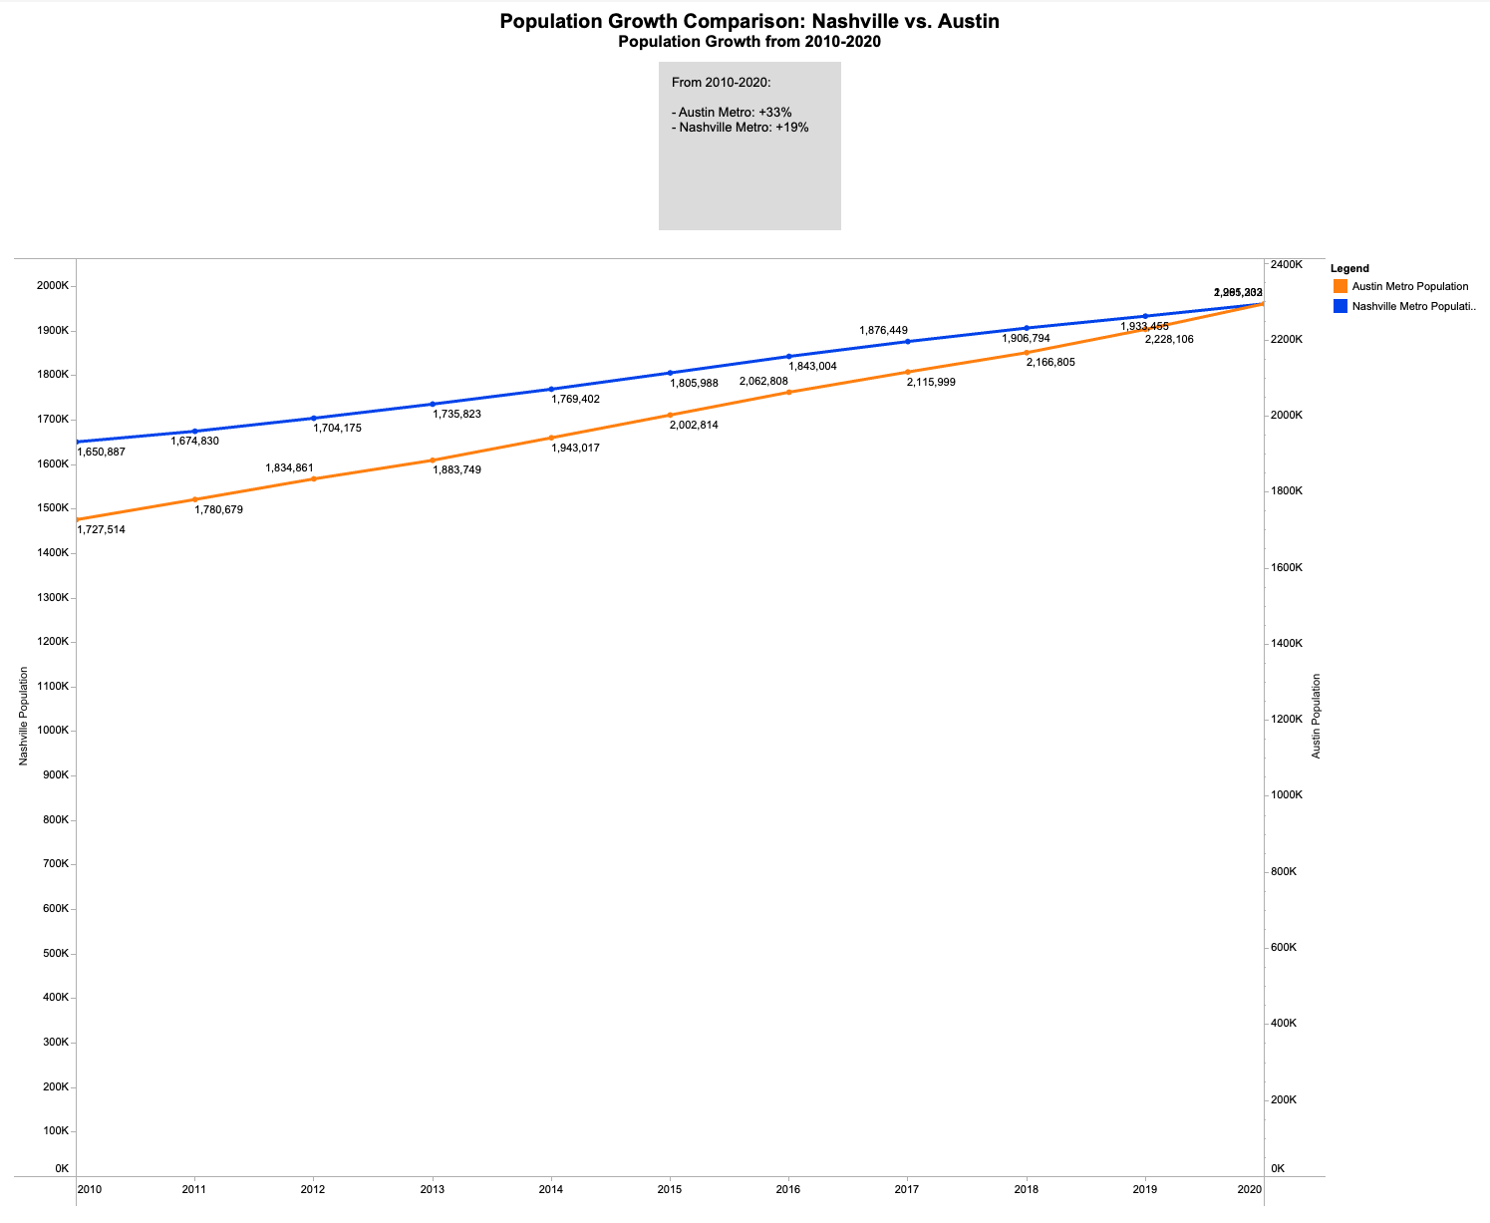
Population Growth
Austin Metro Growth: 33%
Nashville Metro Growth: +19%
~1.9% yearly growth on average for each city, outpaced the national average by 2.5x
Any immediate impacts that may have been caused the COVID-19 pandemic can’t be outright explained by this graph by its own - many outside factors contributed to the consistent growth.
Both metros - as of 2023 - have eclipsed 2 million in population.
Abby Author, CTO
Berry Books, CPO

Slide 8
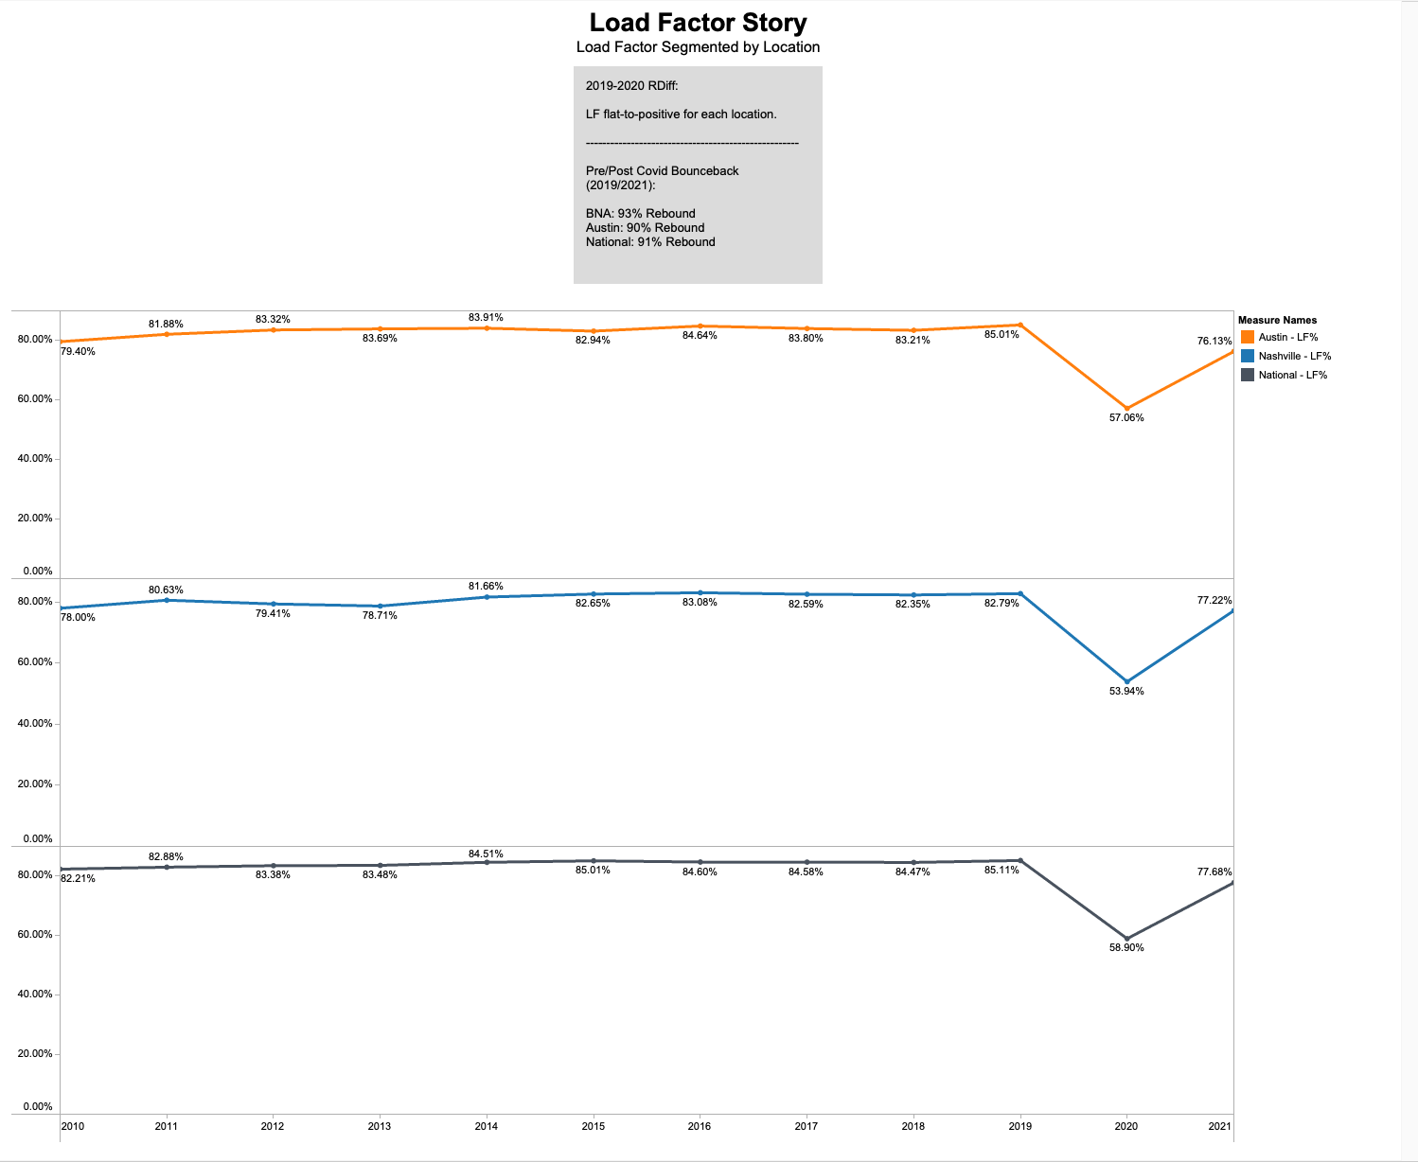
Load Factor
LF was flat-to-positive for each location.
While LF’s were roughly the same for each location, the United States as a whole had the highest average LF during the observation period
US: 81.39%
Austin: 80.42%
Nashville: 78.59%
Initial COVID LF Hit (2020)
Austin: -32.9%
Nashville: -32.8%
National: -30.8%
Covid Bounceback Rates were similar between locations, with Nashville having the highest
Nashville: 93%
US: 91%
Austin: 90%
Abby Author, CTO
Berry Books, CPO

Slide 9
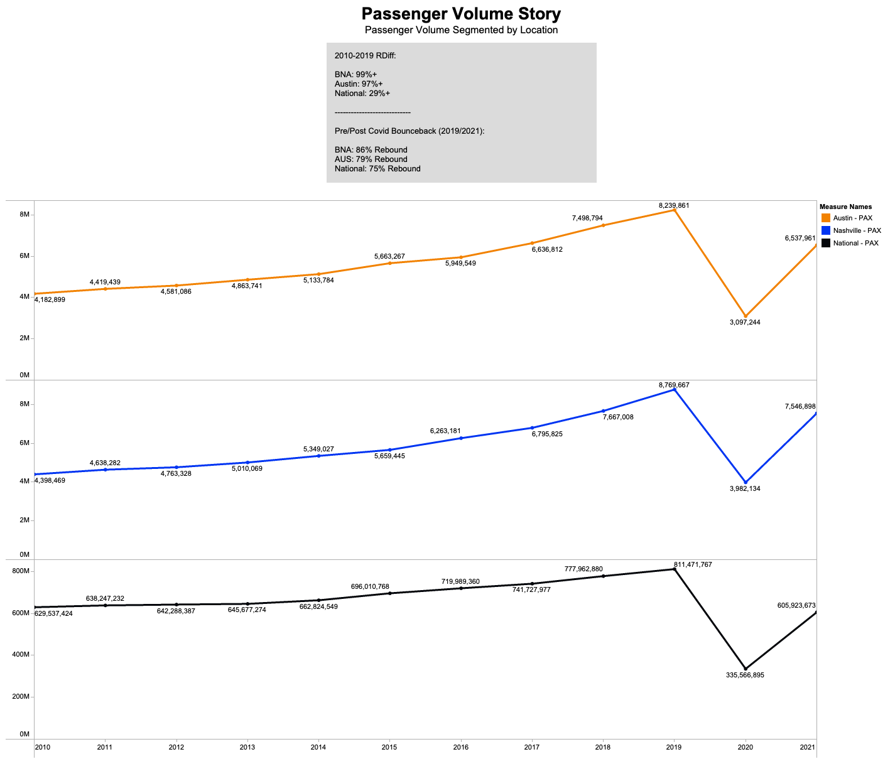
Passenger Volume
Passenger Volume Growth (2010-2019):
Nashville: +99%
Austin: +97%
Nationally: +29%
Initial Covid PAX Volume Hit (2020):
Austin: -62.4%
National: –58.65%
Nashville: -54.65%
Covid Bounceback Rates were lower than with Load Factor, but still significant.
Nashville: 86%
Austin: 79%
National: 75%
Abby Author, CTO
Berry Books, CPO

Slide 10
Conclusion
Both the Austin and Nashville Metro Areas experienced significant growth between 2010-2020.
The trend for Load Factor was flat-to-positive for each location observed, with National figure leading.
Aggregate LF Average: ~80% from 2010-2019
Passenger Volume increased 100% for Austin and Nashville and 30% Nationally.
During 2020, aviation KPI’s took a dramatic hit from 2019.
Passenger Volume: Down ~60%
Load Factor: Down ~30%
In the COVID “bounceback” year - 2021 - both Load Factor and Passenger Volume recovered significantly after the 2020 drop off:
Load Factor: 90% (aggregate)
Passenger Volume: 80% (aggregate)

Slide 11

Abby Author, CTO
Berry Books, CPO

Slide 12
Sources
Question Mark Picture: question-mark-icon-on-white-puzzle-royalty-free-image-917901148-1558452934.jpg
Aviation KPI Data: https://tinyurl.com/5n7eakpn
Nashville and Austin Census Numbers: https://tinyurl.com/5ynu6p3r
National Census Estimation: https://tinyurl.com/mu2z36h7
Thanks for letting me present!
Abby Author, CTO
Berry Books, CPO

